Slide 1
My SQL
Made by: Eng. Doaa m.Abd elfatah

Slide 2
Introduction to SQl with MySQL Engine
Introduction.
Installing Mysql.
Modeling and Designing Databases.
Working with Database Structures.
Basic Select Statement.
Sorting and Filtering Data.
Manipulating Data.

Slide 3
Introduction to SQl with MySQL Engine
Using MYSQL built in functions and grouping functions.
Selecting From Multiple Tables By Join.
Selecting From Multiple Tables By Sub query
Creating views.
Creating Stored Procedures and functions.
Understanding triggers and create it.
Understanding events and create it.

Slide 4
Introduction

Slide 5
What is MYSQL?
MySQL, the most popular Open Source SQL database management system, is developed, distributed, and supported by Oracle Corporation.
The MySQL Web site (http://www.mysql.com/) provides the latest information about MySQL software.

Slide 6
What is MYSQL?
MySQL is a database management system.
MySQL databases are relational.
MySQL software is Open Source.
The MySQL Database Server is very fast, reliable, scalable, and easy to use.
MySQL Server works in client/server or embedded systems.

Slide 7
Installing MYSQL

Slide 8
Installing MYSQL
Download latest version of mysql (popular versions are 5.1,..,5.6 and now 5.7.
Install Mysql server and connect with it using command line.
Or you can use wamp server or others products includes mysql server.
If you want work with GUI you can use Mysql workbench software.
Connect to server using user: root it is the database administrator.

Slide 9

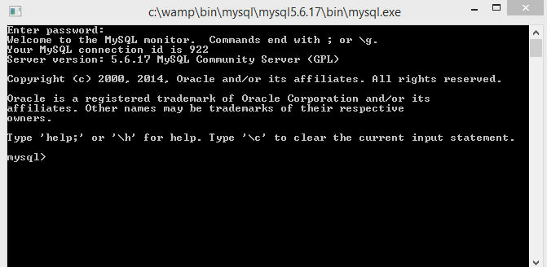
Connect to mysql server using command line

Slide 10
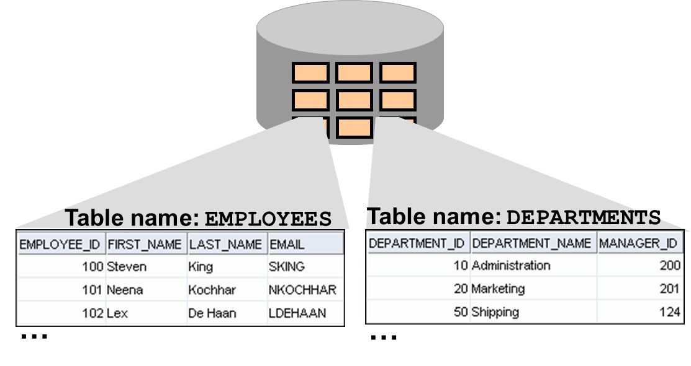
Definition of a Relational Database
A relational database is a collection of relations or two-dimensional tables.

Slide 11
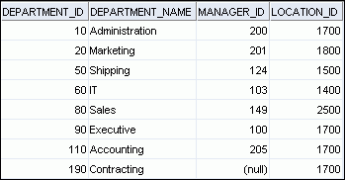
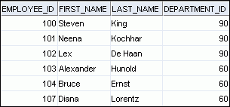
Relating Multiple Tables
Each row of data in a table is uniquely identified by a primary key.
You can logically relate data from multiple tables using foreign keys.
Table name: DEPARTMENTS
Table name: EMPLOYEES
…
Primary key
Foreign key
Primary key
Notes:
Relating Multiple Tables
Each table contains data that describes exactly one entity. For example, the EMPLOYEES table contains information about employees. Categories of data are listed across the top of each table, and individual cases are listed below. By using a table format, you can readily visualize, understand, and use information.
Because data about different entities is stored in different tables, you may need to combine two or more tables to answer a particular question. For example, you may want to know the location of the department where an employee works. In this scenario, you need information from the EMPLOYEES table (which contains data about employees) and the DEPARTMENTS table (which contains information about departments). With an RDBMS, you can relate the data in one table to the data in another by using the foreign keys. A foreign key is a column (or a set of columns) that refers to a primary key in the same table or another table.
You can use the ability to relate data in one table to data in another to organize information in separate, manageable units. Employee data can be kept logically distinct from the department data by storing it in a separate table.

Slide 12
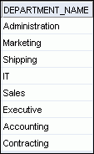
Using SQL to Query Your Database
Structured query language (SQL) is:
The ANSI standard language for operating relational databases
Efficient, easy to learn, and use
Functionally complete (With SQL, you can define, retrieve, and manipulate data in the tables.)
SELECT department_name
FROM departments;
DataBase
Notes:
Using SQL to Query Your Database
In a relational database, you do not specify the access route to the tables, and you do not need to know how the data is arranged physically.
To access the database, you execute a structured query language (SQL) statement, which is the American National Standards Institute (ANSI) standard language for operating relational databases. SQL is a set of statements with which all programs and users access data in an Oracle database. Application programs and Oracle tools often allow users access to the database without using SQL directly, but these applications, in turn, must use SQL when executing the user’s request.
SQL provides statements for a variety of tasks, including:
Querying data
Inserting, updating, and deleting rows in a table
Creating, replacing, altering, and dropping objects
Controlling access to the database and its objects
Guaranteeing database consistency and integrity
SQL unifies all of the preceding tasks in one consistent language and enables you to work with data at a logical level.

Slide 13
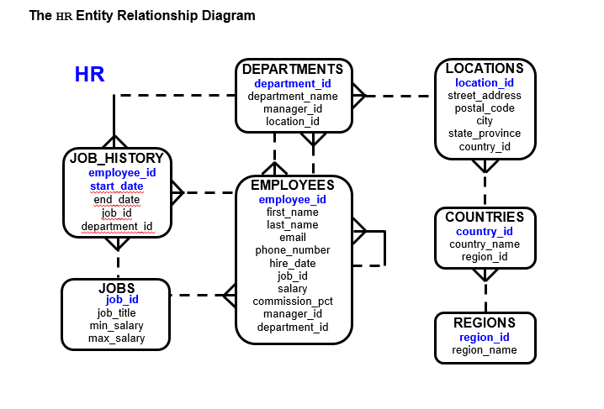

Slide 14
SQL Statements
SELECT
INSERT
UPDATE
DELETE
CREATE
ALTER
DROP
TRUNCATE
GRANT
REVOKE
COMMIT
ROLLBACK
Data manipulation language (DML)
Data definition language (DDL)
Data control language (DCL)
Transaction control
Notes:
SQL Statements
SQL statements supported by Oracle comply with industry standards. Oracle Corporation ensures future compliance with evolving standards by actively involving key personnel in SQL standards committees. The industry-accepted committees are ANSI and International Standards Organization (ISO). Both ANSI and ISO have accepted SQL as the standard language for relational databases.

Slide 15
Create database

Slide 16
Create database
CREATE {DATABASE | SCHEMA} [IF NOT EXISTS] db_name; create_specification:
[DEFAULT] CHARACTER SET [=] charset_name
| [DEFAULT] COLLATE [=] collation_name
You can check the collation and other options of an existing database using the “ show create database db_name; “ statement.

Slide 17
character set
MySQL includes character set support that enables you to store data using a variety of character sets and perform comparisons according to a variety of collations. You can specify character sets at the server, database, table, and column level. MySQL supports the use of character sets for the MyISAM, MEMORY, and InnoDB storage engines.

Slide 18
Character Sets and Collations in General
A character set is a set of symbols and encodings. A collation is a set of rules for comparing characters in a character set. Let's make the distinction clear with an example of an imaginary character set.
Suppose that we have an alphabet with four letters: A, B, a, b. We give each letter a number: A = 0, B = 1, a = 2, b = 3. The letter A is a symbol, the number 0 is the encoding for A, and the combination of all four letters and their encodings is a character set.

Slide 19
Character Sets and Collations in General
Suppose that we want to compare two string values, A and B. The simplest way to do this is to look at the encodings: 0 for A and 1 for B. Because 0 is less than 1, we say A is less than B. What we've just done is apply a collation to our character set. The collation is a set of rules (only one rule in this case): “compare the encodings.” We call this simplest of all possible collations a binary collation.

Slide 20
MySQL can do these things for you:
Store strings using a variety of character sets.
Compare strings using a variety of collations.
Mix strings with different character sets or collations in the same server, the same database, or even the same table.
Enable specification of character set and collation at any level.

Slide 21
Drop database
DROP {DATABASE | SCHEMA} [IF EXISTS] db_name;

Slide 22
Examples
Create database nh;
Use database;
SELECT DATABASE() FROM DUAL; “to show current database”
Drop database nh;

Slide 23
Create table
CREATE TABLE [IF NOT EXISTS] tbl_name
(create_definition,...)
[table_options]
column_definition:
data_type [NOT NULL | NULL] [DEFAULT default_value]
[AUTO_INCREMENT] [UNIQUE [KEY] | [PRIMARY] KEY]

Slide 24
Cloning or Copying a Table
Use CREATE TABLE ... LIKE to create an empty table based on the definition of another table, including any column attributes and indexes defined in the original table:
CREATE TABLE new_tbl LIKE orig_tbl;
CREATE TABLE new_tbl SELECT * FROM orig_tbl;

Slide 25
Mysql Data types
BIT[(length)]
TINYINT[(length)] [UNSIGNED] [ZEROFILL]
SMALLINT[(length)] [UNSIGNED] [ZEROFILL]
MEDIUMINT[(length)] [UNSIGNED] [ZEROFILL]
INT[(length)] [UNSIGNED] [ZEROFILL]
INTEGER[(length)] [UNSIGNED] [ZEROFILL]
BIGINT[(length)] [UNSIGNED] [ZEROFILL]
REAL[(length,decimals)] [UNSIGNED] [ZEROFILL]
DOUBLE[(length,decimals)] [UNSIGNED] [ZEROFILL]
FLOAT[(length,decimals)] [UNSIGNED] [ZEROFILL]
DECIMAL[(length[,decimals])] [UNSIGNED] [ZEROFILL]
NUMERIC[(length[,decimals])] [UNSIGNED] [ZEROFILL]

Slide 26
Mysql Data types
DATE
TIME[(fsp)]
TIMESTAMP[(fsp)]
DATETIME[(fsp)]
YEAR
CHAR[(length)] [BINARY] [CHARACTER SET charset_name] [COLLATE collation_name]
VARCHAR(length) [BINARY] [CHARACTER SET charset_name] [COLLATE collation_name]
BINARY[(length)]
VARBINARY(length)

Slide 27
Mysql Data types
TINYBLOB
BLOB
MEDIUMBLOB
LONGBLOB
TINYTEXT [BINARY] [CHARACTER SET charset_name] [COLLATE collation_name]
TEXT [BINARY] [CHARACTER SET charset_name] [COLLATE collation_name]
MEDIUMTEXT [BINARY] [CHARACTER SET charset_name] [COLLATE collation_name]
LONGTEXT [BINARY] [CHARACTER SET charset_name] [COLLATE collation_name]

Slide 28
Mysql Data types
ENUM(value1,value2,value3,...) [CHARACTER SET charset_name] [COLLATE collation_name]
SET(value1,value2,value3,...) [CHARACTER SET charset_name] [COLLATE collation_name]
JSON
spatial_type

Slide 29
Storage Engines
Storage Engine | Description
InnoDB | Transaction-safe tables with row locking and foreign keys. The default storage engine for new tables.
MyISAM | The binary portable storage engine that is primarily used for read-only or read-mostly workloads.
MEMORY | The data for this storage engine is stored only in memory.
CSV | Tables that store rows in comma-separated values format.
ARCHIVE | The archiving storage engine.
FEDERATED | Storage engine that accesses remote tables.
HEAP | This is a synonym for MEMORY.
MERGE | A collection of MyISAM tables used as one table. Also known as MRG_MyISAM.
NDB | Clustered, fault-tolerant, memory-based tables, supporting transactions and foreign keys. Also known as NDBCLUSTER.

Slide 30
Example
CREATE TABLE t1 (
c1 INT AUTO_INCREMENT PRIMARY KEY,
c2 VARCHAR(100) NOT NULL ,
c3 VARCHAR(100) );

Slide 31
Reset Auto Increment Values
ALTER TABLE table_name AUTO_INCREMENT = value;
MySQL reset auto increment value using TRUNCATE TABLE statement

Slide 32
How To Use The MySQL Generated Columns
CREATE TABLE contacts (
id INT AUTO_INCREMENT PRIMARY KEY,
first_name VARCHAR(50) NOT NULL,
last_name VARCHAR(50) NOT NULL,
fullname varchar(101) GENERATED ALWAYS AS (concat(first_name,' ',last_name)),
email VARCHAR(100) NOT NULL
);
MySQL 5.7 introduces a new feature called generated column. It is called generated column because the data of this column is computed based on a predefined expression or from other columns.
INSERT INTO contacts(first_name,last_name, email)
VALUES('john','doe','john.doe@mysqltutorial.org');

Slide 33
How To Use The MySQL Generated Columns
column_name data_type [GENERATED ALWAYS] AS (expression)
[VIRTUAL | STORED] [UNIQUE [KEY]]
VIRTUAL or STORED. By default, MySQL uses VIRTUAL if you don’t specify the type of the generated column explicitly.
ALTER TABLE products
ADD COLUMN stockValue DOUBLE
GENERATED ALWAYS AS (buyprice*quantityinstock) STORED;

Slide 34
Drop table
DROP TABLE [IF EXISTS]
tbl_name [, tbl_name] ...

Slide 35

Including Constraints
Constraints enforce rules at the table level.
Constraints prevent the deletion of a table if there are dependencies.
The following constraint types are valid:
NOT NULL
UNIQUE
PRIMARY KEY
FOREIGN KEY
Notes:
Constraints
The Oracle server uses constraints to prevent invalid data entry into tables.
You can use constraints to do the following:
Enforce rules on the data in a table whenever a row is inserted, updated, or deleted from that table. The constraint must be satisfied for the operation to succeed.
Prevent the deletion of a table if there are dependencies from other tables.
Provide rules for Oracle tools, such as Oracle Developer.
Data Integrity Constraints

Slide 36
Defining Constraints
Syntax:
Column-level constraint syntax:
Table-level constraint syntax:
CREATE TABLE [schema.]table
(column datatype [DEFAULT expr]
[column_constraint],
...
[table_constraint][,...]);
column [CONSTRAINT constraint_name] constraint_type,
column,...
[CONSTRAINT constraint_name] constraint_type
(column, ...),
Notes:
Defining Constraints
The slide gives the syntax for defining constraints when creating a table. You can create constraints at either the column level or table level. Constraints defined at the column level are included when the column is defined. Table-level constraints are defined at the end of the table definition and must refer to the column or columns on which the constraint pertains in a set of parentheses. It is mainly the syntax that differentiates the two; otherwise, functionally, a column-level constraint is the same as a table-level constraint.
NOT NULL constraints must be defined at the column level.
Constraints that apply to more than one column must be defined at the table level.
In the syntax:
schema Is the same as the owner’s name
table Is the name of the table
DEFAULT expr Specifies a default value to be used if a value is omitted in the INSERT statement
column Is the name of the column
datatype Is the column’s data type and length
column_constraint Is an integrity constraint as part of the column definition
table_constraint Is an integrity constraint as part of the table definition

Slide 37
Defining Constraints
Example of a column-level constraint:
Example of a table-level constraint:
CREATE TABLE employees(
employee_id INT PRIMARY KEY,
first_name VARCHAR(20),
...);
1
CREATE TABLE employees(
employee_id INT
first_name VARCHAR(20),
...
job_id VARCHAR(10) NOT NULL,
PRIMARY KEY (EMPLOYEE_ID));
2
Notes:
Defining Constraints (continued)
Constraints are usually created at the same time as the table. Constraints can be added to a table after its creation and also be temporarily disabled.
Both examples in the slide create a primary key constraint on the EMPLOYEE_ID column of the EMPLOYEES table.
1. The first example uses the column-level syntax to define the constraint.
2. The second example uses the table-level syntax to define the constraint.
More details about the primary key constraint are provided later in this lesson.

Slide 38
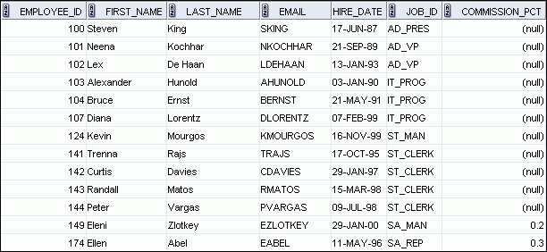
NOT NULL Constraint
Ensures that null values are not permitted for the column:
…
NOT NULL constraint
(Primary Key enforces NOT NULL constraint.)
Absence of NOT NULL constraint (Any row can contain a null value for this column.)
NOT NULL
constraint
Notes:
NOT NULL Constraint
The NOT NULL constraint ensures that the column contains no null values. Columns without the NOT NULL constraint can contain null values by default. NOT NULL constraints must be defined at the column level. In the EMPLOYEES table, the EMPLOYEE_ID column inherits a NOT NULL constraint as it is defined as a primary key. Otherwise, the LAST_NAME, EMAIL, HIRE_DATE, and JOB_ID columns have the NOT NULL constraint enforced on them.
Note: Primary key constraint is discussed in detail later in this lesson.

Slide 39
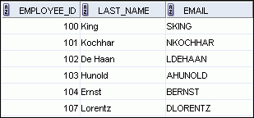
UNIQUE Constraint
UNIQUE constraint
EMPLOYEES
…
INSERT INTO
Allowed
Not allowed: already exists
Notes:
UNIQUE Constraint
A UNIQUE key integrity constraint requires that every value in a column or a set of columns (key) be unique—that is, no two rows of a table can have duplicate values in a specified column or a set of columns. The column (or set of columns) included in the definition of the UNIQUE key constraint is called the unique key. If the UNIQUE constraint comprises more than one column, that group of columns is called a composite unique key.
UNIQUE constraints enable the input of nulls unless you also define NOT NULL constraints for the same columns. In fact, any number of rows can include nulls for columns without the NOT NULL constraints because nulls are not considered equal to anything. A null in a column (or in all columns of a composite UNIQUE key) always satisfies a UNIQUE constraint.
Note: Because of the search mechanism for the UNIQUE constraints on more than one column, you cannot have identical values in the non-null columns of a partially null composite UNIQUE key constraint.

Slide 40
UNIQUE Constraint
Defined at either the table level or the column level:
CREATE TABLE employees(
employee_id INT,
last_name VARCHAR(25) NOT NULL,
email VARCHAR(25),
salary DECIMAL(8,2),
commission_pct DECIMAL (2,2),
hire_date DATE NOT NULL,
...
UNIQUE(email));
Notes:
UNIQUE Constraint (continued)
UNIQUE constraints can be defined at the column level or table level. You define the constraint at the table level when you want to create a composite unique key. A composite key is defined when there is not a single attribute that can uniquely identify a row. In that case, you can have a unique key that is composed of two or more columns, the combined value of which is always unique and can identify rows.
The example in the slide applies the UNIQUE constraint to the EMAIL column of the EMPLOYEES table. The name of the constraint is EMP_EMAIL_UK.
Note: The Oracle server enforces the UNIQUE constraint by implicitly creating a unique index on the unique key column or columns.

Slide 41
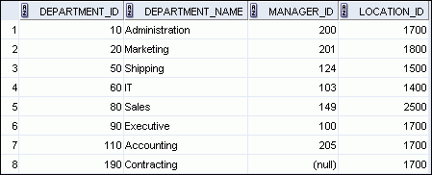
PRIMARY KEY Constraint
DEPARTMENTS
PRIMARY KEY
Not allowed
(null value)
INSERT INTO
Not allowed
(50 already exists)
Notes:
PRIMARY KEY Constraint
A PRIMARY KEY constraint creates a primary key for the table. Only one primary key can be created for each table. The PRIMARY KEY constraint is a column or a set of columns that uniquely identifies each row in a table. This constraint enforces the uniqueness of the column or column combination and ensures that no column that is part of the primary key can contain a null value.
Note: Because uniqueness is part of the primary key constraint definition, the Oracle server enforces the uniqueness by implicitly creating a unique index on the primary key column or columns.

Slide 42
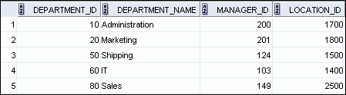
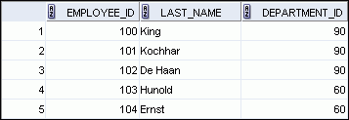

FOREIGN KEY Constraint
DEPARTMENTS
PRIMARY KEY
…
EMPLOYEES
FOREIGN KEY
…
INSERT INTO
Not allowed (9 does not exist)
Allowed
Notes:
FOREIGN KEY Constraint
The FOREIGN KEY (or referential integrity) constraint designates a column or a combination of columns as a foreign key and establishes a relationship with a primary key or a unique key in the same table or a different table.
In the example in the slide, DEPARTMENT_ID has been defined as the foreign key in the EMPLOYEES table (dependent or child table); it references the DEPARTMENT_ID column of the DEPARTMENTS table (the referenced or parent table).
Guidelines
A foreign key value must match an existing value in the parent table or be NULL.
Foreign keys are based on data values and are purely logical, rather than physical, pointers.

Slide 43
FOREIGN KEY Constraint
Defined at either the table level or the column level:
CREATE TABLE employees(
employee_id INT AUTOINCREMENT PRIMARY KEY,
last_name VARCHAR(25) NOT NULL,
email VARCHAR(25),
salary DECIMAL(8,2),
commission_pct DECIMAL(2,2),
hire_date DATE NOT NULL,
...
department_id INT
CONSTRAINT emp_dept_fk FOREIGN KEY (department_id)
REFERENCES departments(department_id),
UNIQUE(email));
Notes:
FOREIGN KEY Constraint (continued)
FOREIGN KEY constraints can be defined at the column or table constraint level. A composite foreign key must be created by using the table-level definition.
The example in the slide defines a FOREIGN KEY constraint on the DEPARTMENT_ID column of the EMPLOYEES table, using table-level syntax. The name of the constraint is EMP_DEPT_FK.
The foreign key can also be defined at the column level, provided that the constraint is based on a single column. The syntax differs in that the keywords FOREIGN KEY do not appear. For example:
CREATE TABLE employees
(...
department_id NUMBER(4) CONSTRAINT emp_deptid_fk
REFERENCES departments(department_id),
...
)

Slide 44
FOREIGN KEY Constraint: Keywords
ON DELETE CASCADE: Deletes the dependent rows in the child table when a row in the parent table is deleted
ON DELETE SET NULL: Converts dependent foreign key values to null
ON UPDATE CASCADE: UPDATES the dependent rows in the child table when a row in the parent table is UPDATED
ON UPDATE SET NULL: Converts dependent foreign key values to null
Notes:
FOREIGN KEY Constraint: Keywords
The foreign key is defined in the child table and the table containing the referenced column is the parent table. The foreign key is defined using a combination of the following keywords:
FOREIGN KEY is used to define the column in the child table at the table-constraint level.
REFERENCES identifies the table and the column in the parent table.
ON DELETE CASCADE indicates that when a row in the parent table is deleted, the dependent rows in the child table are also deleted.
ON DELETE SET NULL indicates that when a row in the parent table is deleted, the foreign key values are set to null.
The default behavior is called the restrict rule, which disallows the update or deletion of referenced data.
Without the ON DELETE CASCADE or the ON DELETE SET NULL options, the row in the parent table cannot be deleted if it is referenced in the child table.

Slide 45
SELECT STATMENT
Basic SELECT

Slide 46
Capabilities of SQL SELECT Statements
Projection
Selection
Table 1
Table 1
Join
Table 1
Table 2
Notes:
Capabilities of SQL SELECT Statements
A SELECT statement retrieves information from the database. With a SELECT statement, you can use the following capabilities:
Projection: Select the columns in a table that are returned by a query. Select as few or as many of the columns as required.
Selection: Select the rows in a table that are returned by a query. Various criteria can be used to restrict the rows that are retrieved.
Joining: Bring together data that is stored in different tables by specifying the link between them. SQL joins are covered in more detail in the lesson titled “Displaying Data from Multiple Tables.”

Slide 47
Basic SELECT Statement
SELECT *|{[DISTINCT] column|expression [alias],...}
FROM table;
SELECT identifies the columns to be displayed.
FROM identifies the table containing those columns.
Notes:
Basic SELECT Statement
In its simplest form, a SELECT statement must include the following:
A SELECT clause, which specifies the columns to be displayed
A FROM clause, which identifies the table containing the columns that are listed in the SELECT clause
In the syntax:
SELECT is a list of one or more columns
* selects all columns
DISTINCT suppresses duplicates
column|expression selects the named column or the expression
alias gives the selected columns different headings
FROM table specifies the table containing the columns
Note: Throughout this course, the words keyword, clause, and statement are used as follows:
A keyword refers to an individual SQL element. For example, SELECT and FROM are keywords.
A clause is a part of a SQL statement. For example, SELECT employee_id, last_name, and so on is a clause.
A statement is a combination of two or more clauses. For example, SELECT * FROM employees is a SQL statement.

Slide 48
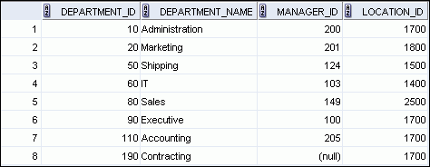
Selecting All Columns
SELECT *
FROM departments;
Notes:
Selecting All Columns
You can display all columns of data in a table by following the SELECT keyword with an asterisk (*). In the example in the slide, the department table contains four columns: DEPARTMENT_ID, DEPARTMENT_NAME, MANAGER_ID, and LOCATION_ID. The table contains eight rows, one for each department.
You can also display all columns in the table by listing all the columns after the SELECT keyword. For example, the following SQL statement (like the example in the slide) displays all columns and all rows of the DEPARTMENTS table:
SELECT department_id, department_name, manager_id, location_id FROM departments;
Note: In SQL Developer, you can enter your SQL statement in a SQL Worksheet and click the “Execute Statement” icon or press [F9] to execute the statement. The output displayed in the Results tabbed page appears as shown in the slide.

Slide 49
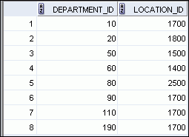
Selecting Specific Columns
SELECT department_id, location_id
FROM departments;
Notes:
Selecting Specific Columns
You can use the SELECT statement to display specific columns of the table by specifying the column names, separated by commas. The example in the slide displays all the department numbers and location numbers from the DEPARTMENTS table.
In the SELECT clause, specify the columns that you want in the order in which you want them to appear in the output. For example, to display location before department number (from left to right), you use the following statement:
SELECT location_id, department_id
FROM departments;
…

Slide 50
Arithmetic Expressions
Create expressions with number and date data by using arithmetic operators.
Operator
Description
+
Add
-
Subtract
*
Multiply
/
Divide
Notes:
Arithmetic Expressions
You may need to modify the way in which data is displayed, or you may want to perform calculations, or look at what-if scenarios. All these are possible using arithmetic expressions. An arithmetic expression can contain column names, constant numeric values, and the arithmetic operators.
Arithmetic Operators
The slide lists the arithmetic operators that are available in SQL. You can use arithmetic operators in any clause of a SQL statement (except the FROM clause).
Note: With the DATE and TIMESTAMP data types, you can use the addition and subtraction operators only.

Slide 51
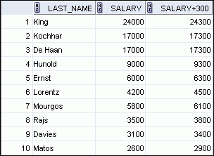
Using Arithmetic Operators
SELECT last_name, salary, salary + 300
FROM employees;
…
Notes:
Using Arithmetic Operators
The example in the slide uses the addition operator to calculate a salary increase of $300 for all employees. The slide also displays a SALARY+300 column in the output.
Note that the resultant calculated column, SALARY+300, is not a new column in the EMPLOYEES table; it is for display only. By default, the name of a new column comes from the calculation that generated it—in this case, salary+300.
Note: The Oracle server ignores blank spaces before and after the arithmetic operator.
Operator Precedence
If an arithmetic expression contains more than one operator, multiplication and division are evaluated first. If operators in an expression are of the same priority, then evaluation is done from left to right.
You can use parentheses to force the expression that is enclosed by the parentheses to be evaluated first.
Rules of Precedence:
Multiplication and division occur before addition and subtraction.
Operators of the same priority are evaluated from left to right.
Parentheses are used to override the default precedence or to clarify the statement.

Slide 52


Operator Precedence
SELECT last_name, salary, 12*salary+100
FROM employees;
1
…
SELECT last_name, salary, 12*(salary+100)
FROM employees;
2
…
Notes:
Operator Precedence (continued)
The first example in the slide displays the last name, salary, and annual compensation of employees. It calculates the annual compensation by multiplying the monthly salary with 12, plus a one-time bonus of $100. Note that multiplication is performed before addition.
Note: Use parentheses to reinforce the standard order of precedence and to improve clarity. For example, the expression in the slide can be written as (12*salary)+100 with no change in the result.
Using Parentheses
You can override the rules of precedence by using parentheses to specify the desired order in which the operators are to be executed.
The second example in the slide displays the last name, salary, and annual compensation of employees. It calculates the annual compensation as follows: adding a monthly bonus of $100 to the monthly salary, and then multiplying that subtotal with 12. Because of the parentheses, addition takes priority over multiplication.

Slide 53



Defining a Null Value
Null is a value that is unavailable, unassigned, unknown, or inapplicable.
Null is not the same as zero or a blank space.
SELECT last_name, job_id, salary, commission_pct
FROM employees;
…
…
Notes:
Defining a Null Value
If a row lacks a data value for a particular column, that value is said to be null or to contain a null.
Null is a value that is unavailable, unassigned, unknown, or inapplicable. Null is not the same as zero or a blank space. Zero is a number and blank space is a character.
Columns of any data type can contain nulls. However, some constraints (NOT NULL and PRIMARY KEY) prevent nulls from being used in the column.
In the COMMISSION_PCT column in the EMPLOYEES table, notice that only a sales manager or sales representative can earn a commission. Other employees are not entitled to earn commissions. A null represents that fact.
Note: By default, SQL Developer uses the literal, (null), to identify null values. However, you can set it to something more relevant to you. To do so, select Preferences from the Tools menu. In the Preferences dialog box, expand the Database node. Click Advanced Parameters and on the right pane, for the “Display Null value As,” enter the appropriate value.

Slide 54


Null Values in Arithmetic Expressions
Arithmetic expressions containing a null value evaluate to null.
SELECT last_name, 12*salary*commission_pct
FROM employees;
…
…
You can use ifnull or COALESCE functions to replace null to any value
SELECT last_name, 12*salary*IFNULL(commission_pct,0)
FROM employees;
Notes:
Null Values in Arithmetic Expressions
If any column value in an arithmetic expression is null, the result is null. For example, if you attempt to perform division by zero, you get an error. However, if you divide a number by null, the result is a null or unknown.
In the example in the slide, employee King does not get any commission. Because the COMMISSION_PCT column in the arithmetic expression is null, the result is null.
For more information, see the section on “Basic Elements of Oracle SQL” in Oracle Database SQL Language Reference 11g, Release 1 (11.1).

Slide 55


Using Column Aliases
SELECT last_name AS name, commission_pct comm
FROM employees;
…
SELECT last_name "Name" , salary*12 "Annual Salary"
FROM employees;
…
Notes:
Using Column Aliases
The first example displays the names and the commission percentages of all the employees. Note that the optional AS keyword has been used before the column alias name. The result of the query is the same whether the AS keyword is used or not. Also, note that the SQL statement has the column aliases, name and comm, in lowercase, whereas the result of the query displays the column headings in uppercase. As mentioned in the previous slide, column headings appear in uppercase by default.
The second example displays the last names and annual salaries of all the employees. Because Annual Salary contains a space, it has been enclosed in double quotation marks. Note that the column heading in the output is exactly the same as the column alias.

Slide 56
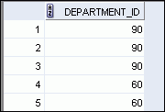
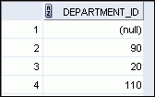
Duplicate Rows
The default display of queries is all rows, including duplicate rows.
1
SELECT department_id
FROM employees;
…
2
SELECT DISTINCT department_id
FROM employees;
…
Notes:
Duplicate Rows
Unless you indicate otherwise, SQL displays the results of a query without eliminating the duplicate rows. The first example in the slide displays all the department numbers from the EMPLOYEES table. Note that the department numbers are repeated.
To eliminate duplicate rows in the result, include the DISTINCT keyword in the SELECT clause immediately after the SELECT keyword. In the second example in the slide, the EMPLOYEES table actually contains 20 rows, but there are only seven unique department numbers in the table.
You can specify multiple columns after the DISTINCT qualifier. The DISTINCT qualifier affects all the selected columns, and the result is every distinct combination of the columns.
SELECT DISTINCT department_id, job_id
FROM employees;
…

Slide 57
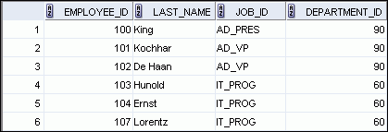

Limiting Rows Using a Selection
EMPLOYEES
…
“retrieve all employees in department 90”
Notes:
Limiting Rows Using a Selection
In the example in the slide, assume that you want to display all the employees in department 90. The rows with a value of 90 in the DEPARTMENT_ID column are the only ones that are returned. This method of restriction is the basis of the WHERE clause in SQL.

Slide 58
Limiting the Rows that Are Selected
Restrict the rows that are returned by using the WHERE clause:
The WHERE clause follows the FROM clause.
SELECT *|{[DISTINCT] column|expression [alias],...}
FROM table
[WHERE condition(s)];
Notes:
Limiting the Rows that Are Selected
You can restrict the rows that are returned from the query by using the WHERE clause. A WHERE clause contains a condition that must be met and it directly follows the FROM clause. If the condition is true, the row meeting the condition is returned.
In the syntax:
WHERE restricts the query to rows that meet a condition
condition is composed of column names, expressions, constants, and a comparison operator. A condition specifies a combination of one or more expressions and logical (Boolean) operators, and returns a value of TRUE, FALSE, or UNKNOWN.
The WHERE clause can compare values in columns, literal, arithmetic expressions, or functions. It consists of three elements:
Column name
Comparison condition
Column name, constant, or list of values

Slide 59

Using the WHERE Clause
SELECT employee_id, last_name, job_id, department_id
FROM employees
WHERE department_id = 90 ;
Notes:
Using the WHERE Clause
In the example, the SELECT statement retrieves the employee ID, last name, job ID, and department number of all employees who are in department 90.
Note: You cannot use column alias in the WHERE clause.

Slide 60
Comparison Operators
Operator
Meaning
=
Equal to
>
Greater than
>=
Greater than or equal to
<
Less than
<=
Less than or equal to
<>
Not equal to
BETWEEN ...AND...
Between two values (inclusive)
IN(set)
Match any of a list of values
LIKE
Match a character pattern
IS NULL
Is a null value
Notes:
Comparison Operators
Comparison operators are used in conditions that compare one expression to another value or expression. They are used in the WHERE clause in the following format:
Syntax
... WHERE expr operator value
Example
... WHERE hire_date = '01-JAN-95'
... WHERE salary >= 6000
... WHERE last_name = 'Smith'
An alias cannot be used in the WHERE clause.
Note: The symbols != and ^= can also represent the not equal to condition.

Slide 61
Defining Conditions Using the Logical Operators
Operator
Meaning
AND
Returns TRUE if both component conditions are true
OR
Returns TRUE if either component condition is true
NOT
Returns TRUE if the condition is false
Notes:
Defining Conditions Using the Logical Operators
A logical condition combines the result of two component conditions to produce a single result based on those conditions or it inverts the result of a single condition. A row is returned only if the overall result of the condition is true.
Three logical operators are available in SQL:
AND
OR
NOT
All the examples so far have specified only one condition in the WHERE clause. You can use several conditions in a single WHERE clause using the AND and OR operators.

Slide 62
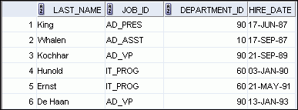
Using the ORDER BY Clause
Sort retrieved rows with the ORDER BY clause:
ASC: Ascending order, default
DESC: Descending order
The ORDER BY clause comes last in the SELECT statement:
SELECT last_name, job_id, department_id, hire_date
FROM employees
ORDER BY hire_date ;
…
Notes:
Using the ORDER BY Clause
The order of rows that are returned in a query result is undefined. The ORDER BY clause can be used to sort the rows. However, if you use the ORDER BY clause, it must be the last clause of the SQL statement. Further, you can specify an expression, an alias, or a column position as the sort condition.
Syntax
SELECT expr
FROM table
[WHERE condition(s)]
[ORDER BY {column, expr, numeric_position} [ASC|DESC]];
In the syntax:
ORDER BY specifies the order in which the retrieved rows are displayed
ASC orders the rows in ascending order (this is the default order)
DESC orders the rows in descending order
If the ORDER BY clause is not used, the sort order is undefined, and the Oracle server may not fetch rows in the same order for the same query twice. Use the ORDER BY clause to display the rows in a specific order.
Note: Use the keywords NULLS FIRST or NULLS LAST to specify whether returned rows containing null values should appear first or last in the ordering sequence.

Slide 63
Sorting
Sorting in descending order:
Sorting by column alias:
SELECT last_name, job_id, department_id, hire_date
FROM employees
ORDER BY hire_date DESC ;
1
SELECT employee_id, last_name, salary*12 annsal
FROM employees
ORDER BY annsal ;
2
Notes:
Sorting
The default sort order is ascending:
Numeric values are displayed with the lowest values first (for example, 1 to 999).
Date values are displayed with the earliest value first (for example, 01-JAN-92 before 01-JAN-95).
Character values are displayed in the alphabetical order (for example, “A” first and “Z” last).
Null values are displayed last for ascending sequences and first for descending sequences.
You can also sort by a column that is not in the SELECT list.
Examples:
1. To reverse the order in which the rows are displayed, specify the DESC keyword after the column name in the ORDER BY clause. The slide example sorts the result by the most recently hired employee.
2. You can also use a column alias in the ORDER BY clause. The slide example sorts the data by annual salary.

Slide 64
Sorting
Sorting by using the column’s numeric position:
Sorting by multiple columns:
SELECT last_name, job_id, department_id, hire_date
FROM employees
ORDER BY 3;
3
SELECT last_name, department_id, salary
FROM employees
ORDER BY department_id, salary DESC;
4
Notes:
Sorting (continued)
Examples:
3. You can sort query results by specifying the numeric position of the column in the SELECT clause. The slide example sorts the result by the department_id as this column is at the third position in the SELECT clause.
4. You can sort query results by more than one column. The sort limit is the number of columns in the given table. In the ORDER BY clause, specify the columns and separate the column names using commas. If you want to reverse the order of a column, specify DESC after its name.

Slide 65
Manipulating Data
Dml

Slide 66
Data Manipulation Language
A DML statement is executed when you:
Add new rows to a table
Modify existing rows in a table
Remove existing rows from a table
Notes:
Data Manipulation Language
Data manipulation language (DML) is a core part of SQL. When you want to add, update, or delete data in the database, you execute a DML statement. A collection of DML statements that form a logical unit of work is called a transaction.
Consider a banking database. When a bank customer transfers money from a savings account to a checking account, the transaction might consist of three separate operations: decreasing the savings account, increasing the checking account, and recording the transaction in the transaction journal. The Oracle server must guarantee that all the three SQL statements are performed to maintain the accounts in proper balance. When something prevents one of the statements in the transaction from executing, the other statements of the transaction must be undone.
Note: Most of the DML statements in this lesson assume that no constraints on the table are violated. Constraints are discussed later in this course.
Note: In SQL Developer, click the Run Script icon or press [F5] to run the DML statements. The feedback messages will be shown on the Script Output tabbed page.

Slide 67
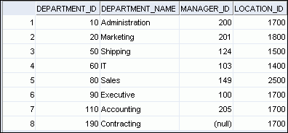
Adding a New Row to a Table
New
row
DEPARTMENTS
Insert new row into the DEPARTMENTS table.
Notes:
Adding a New Row to a Table
The graphic in the slide illustrates the addition of a new department to the DEPARTMENTS table.

Slide 68
INSERT Statement Syntax
Add new rows to a table by using the INSERT statement:
INSERT INTO table [(column [, column...])]
VALUES (value [, value...]), (value [, value...]),…;
Notes:
INSERT Statement Syntax
You can add new rows to a table by issuing the INSERT statement.
In the syntax:
table is the name of the table
column is the name of the column in the table to populate
value is the corresponding value for the column
Note: This statement with the VALUES clause adds only one row at a time to a table.

Slide 69
Inserting New Rows
Insert a new row containing values for each column.
List values in the default order of the columns in the table.
Optionally, list the columns in the INSERT clause.
Enclose character and date values within single quotation marks.
INSERT INTO departments(department_id,
department_name, manager_id, location_id)
VALUES (70, 'Public Relations', 100, 1700);
Notes:
Inserting New Rows
Because you can insert a new row that contains values for each column, the column list is not required in the INSERT clause. However, if you do not use the column list, the values must be listed according to the default order of the columns in the table, and a value must be provided for each column.
DESCRIBE departments
For clarity, use the column list in the INSERT clause. Enclose character and date values within single quotation marks; however, it is not recommended that you enclose numeric values within single quotation marks.

Slide 70
Inserting Rows with Null Values
Implicit method: Omit the column from the column list.
Explicit method: Specify the NULL keyword in the VALUES clause.
INSERT INTO departments (department_id,
department_name)
VALUES (30, 'Purchasing');
INSERT INTO departments
VALUES (100, 'Finance', NULL, NULL);
Notes:
Inserting Rows with Null Values
Be sure that you can use null values in the targeted column by verifying the Null status with the DESCRIBE command.
The Oracle server automatically enforces all data types, data ranges, and data integrity constraints. Any column that is not listed explicitly obtains a null value in the new row.
Common errors that can occur during user input are checked in the following order:
Mandatory value missing for a NOT NULL column
Duplicate value violating any unique or primary key constraint
Any value violating a CHECK constraint
Referential integrity maintained for foreign key constraint
Data type mismatches or values too wide to fit in column
Note: Use of the column list is recommended as it makes the INSERT statement more readable and reliable, or less prone to mistakes.

Slide 71
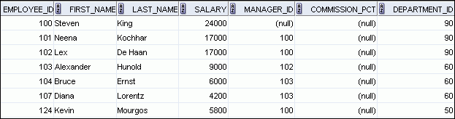

Changing Data in a Table
EMPLOYEES
Update rows in the EMPLOYEES table:
Notes:
Changing Data in a Table
The slide illustrates changing the department number for employees in department 60 to department 80.

Slide 72
UPDATE Statement Syntax
Modify existing values in a table with the UPDATE statement:
Update more than one row at a time (if required).
UPDATE table
SET column = value [, column = value, ...]
[WHERE condition];
Notes:
UPDATE Statement Syntax
You can modify the existing values in a table by using the UPDATE statement.
In the syntax:
table is the name of the table
column is the name of the column in the table to populate
value is the corresponding value or subquery for the column
condition identifies the rows to be updated and is composed of column names, expressions, constants, subqueries, and comparison operators
Confirm the update operation by querying the table to display the updated rows.
For more information, see the section on “UPDATE” in the Oracle Database SQL Language Reference 11g, Release 1 (11.1).
Note: In general, use the primary key column in the WHERE clause to identify a single row for update. Using other columns can unexpectedly cause several rows to be updated. For example, identifying a single row in the EMPLOYEES table by name is dangerous, because more than one employee may have the same name.

Slide 73
Updating Rows in a Table
Values for a specific row or rows are modified if you specify the WHERE clause:
Values for all the rows in the table are modified if you omit the WHERE clause:
Specify SET column_name= NULL to update a column value to NULL.
UPDATE employees
SET department_id = 50
WHERE employee_id = 113;
UPDATE copy_emp
SET department_id = 110;
Notes:
Updating Rows in a Table
The UPDATE statement modifies the values of a specific row or rows if the WHERE clause is specified. The example in the slide shows the transfer of employee 113 (Popp) to department 50.
If you omit the WHERE clause, values for all the rows in the table are modified. Examine the updated rows in the COPY_EMP table.
SELECT last_name, department_id
FROM copy_emp;
For example, an employee who was a SA_REP has now changed his job to an IT_PROG. Therefore, his JOB_ID needs to be updated and the commission field needs to be set to NULL.
UPDATE employees
SET job_id = ‘IT_PROG’, commission_pct = NULL
WHERE employee_id = 114;
Note: The COPY_EMP table has the same data as the EMPLOYEES table.
…

Slide 74
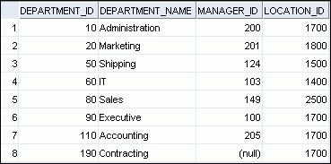
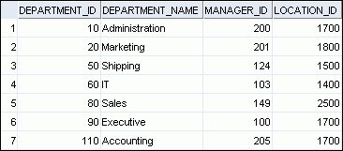
Removing a Row from a Table
DEPARTMENTS
Delete a row from the DEPARTMENTS table:
Notes:
Removing a Row from a Table
The Contracting department has been removed from the DEPARTMENTS table (assuming no constraints on the DEPARTMENTS table are violated), as shown by the graphic in the slide.

Slide 75
DELETE Statement
You can remove existing rows from a table by using the DELETE statement:
DELETE FROM table
[WHERE condition];
Notes:
DELETE Statement Syntax
You can remove existing rows from a table by using the DELETE statement.
In the syntax:
table is the name of the table
condition identifies the rows to be deleted, and is composed of column names, expressions, constants, subqueries, and comparison operators
Note: If no rows are deleted, the message “0 rows deleted” is returned (in the Script Output tab in SQL Developer)
For more information, see the section on “DELETE” in Oracle Database SQL Language Reference 11g, Release 1 (11.1).

Slide 76
Deleting Rows from a Table
Specific rows are deleted if you specify the WHERE clause:
All rows in the table are deleted if you omit the WHERE clause:
DELETE FROM departments
WHERE department_name = ‘Finance';
DELETE FROM copy_emp;
Notes:
Deleting Rows from a Table
You can delete specific rows by specifying the WHERE clause in the DELETE statement. The first example in the slide deletes the Accounting department from the DEPARTMENTS table. You can confirm the delete operation by displaying the deleted rows using the SELECT statement.
SELECT *
FROM departments
WHERE department_name = ‘Finance';
However, if you omit the WHERE clause, all rows in the table are deleted. The second example in the slide deletes all rows from the COPY_EMP table, because no WHERE clause was specified.
Example:
Remove rows identified in the WHERE clause.
DELETE FROM employees WHERE employee_id = 114;
DELETE FROM departments WHERE department_id IN (30, 40);

Slide 77
TRUNCATE Statement
Removes all rows from a table, leaving the table empty and the table structure intact
Is a data definition language (DDL) statement rather than a DML statement; cannot easily be undone
It requires the DROP privilege.
Syntax:
Example:
TRUNCATE TABLE table_name;
TRUNCATE TABLE copy_emp;
Notes:
TRUNCATE Statement
A more efficient method of emptying a table is by using the TRUNCATE statement. You can use the TRUNCATE statement to quickly remove all rows from a table or cluster. Removing rows with the TRUNCATE statement is faster than removing them with the DELETE statement for the following reasons:
The TRUNCATE statement is a data definition language (DDL) statement and generates no rollback information. Rollback information is covered later in this lesson.
Truncating a table does not fire the delete triggers of the table.
If the table is the parent of a referential integrity constraint, you cannot truncate the table. You need to disable the constraint before issuing the TRUNCATE statement. Disabling constraints is covered in a subsequent lesson.

Slide 78
Database Transactions
In InnoDB, all user activity occurs inside a transaction.
If autocommit mode is enabled, each SQL statement forms a single transaction on its own.
By default, MySQL starts the session for each new connection with autocommit enabled, so MySQL does a commit after each SQL statement if that statement did not return an error. If a statement returns an error, the commit or rollback behavior depends on the error.

Slide 79
Database Transactions
A session that has autocommit enabled can perform a multiple-statement transaction by starting it with an explicit START TRANSACTION or BEGIN statement and ending it with a COMMIT or ROLLBACK statement.
To use multiple-statement transactions, switch autocommit off with the SQL statement SET autocommit = 0 and end each transaction with COMMIT or ROLLBACK as appropriate.

Slide 80
Database Transactions
mysql> CREATE TABLE customer (a INT, b CHAR (20), INDEX (a));
mysql> -- Do a transaction with autocommit turned on.
mysql> START TRANSACTION;
mysql> INSERT INTO customer VALUES (10, 'Heikki');
mysql> COMMIT;
mysql> -- Do another transaction with autocommit turned off.
mysql> SET autocommit=0;
mysql> INSERT INTO customer VALUES (15, 'John');
INSERT INTO customer VALUES (20, 'Paul');
mysql> DELETE FROM customer WHERE b = 'Heikki';
mysql> -- Now we undo those last 2 inserts and the delete.
mysql> ROLLBACK;
mysql> SELECT * FROM customer;
+------+--------+
| a | b |
+------+--------+
| 10 | Heikki |
+------+--------+
1 row in set (0.00 sec)
mysql>

